Slide 1


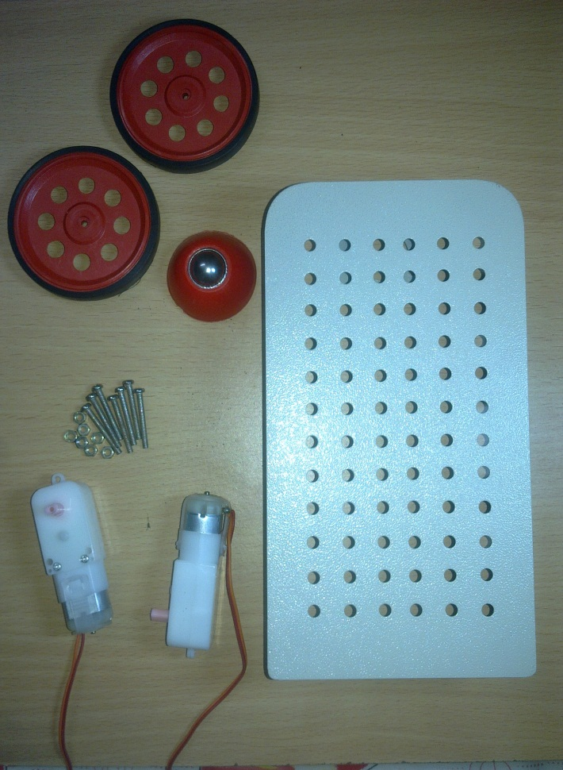
Society of Robotics and Automation, VJTI
HOW TO ASSEMBLE THE BOT

Slide 2
Society of Robotics and Automation, VJTI
The various parts to be assembled are
1.Chassis
2.Motors
3.Wheels
4.Caster

Slide 3
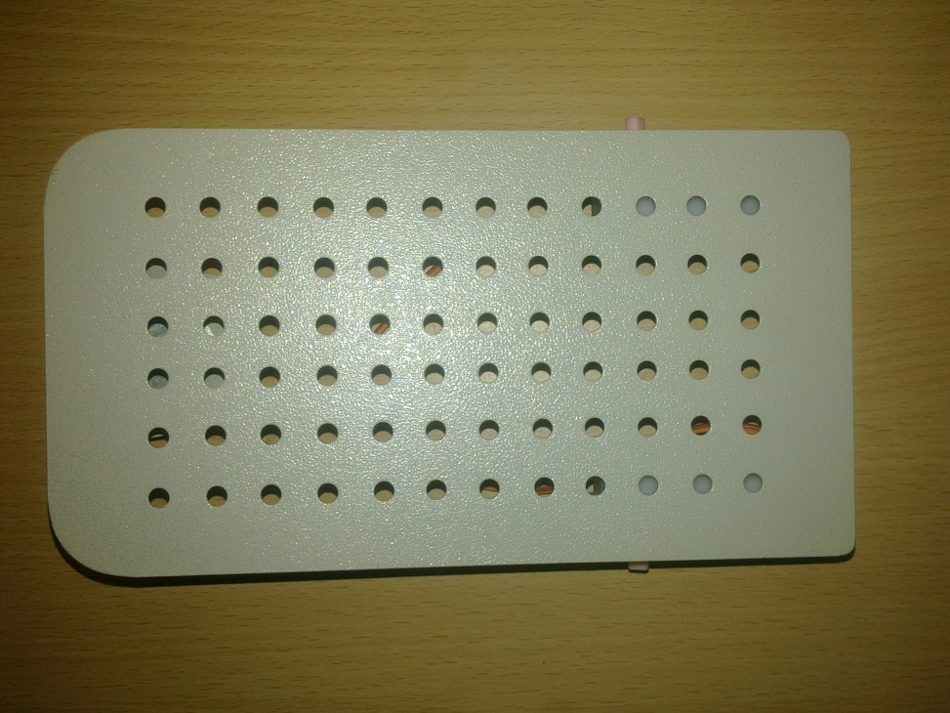
Society of Robotics and Automation, VJTI
Chassis
A chassis consists of an internal framework that supports the bot. It is analogous to an animal's skeleton.

Slide 4
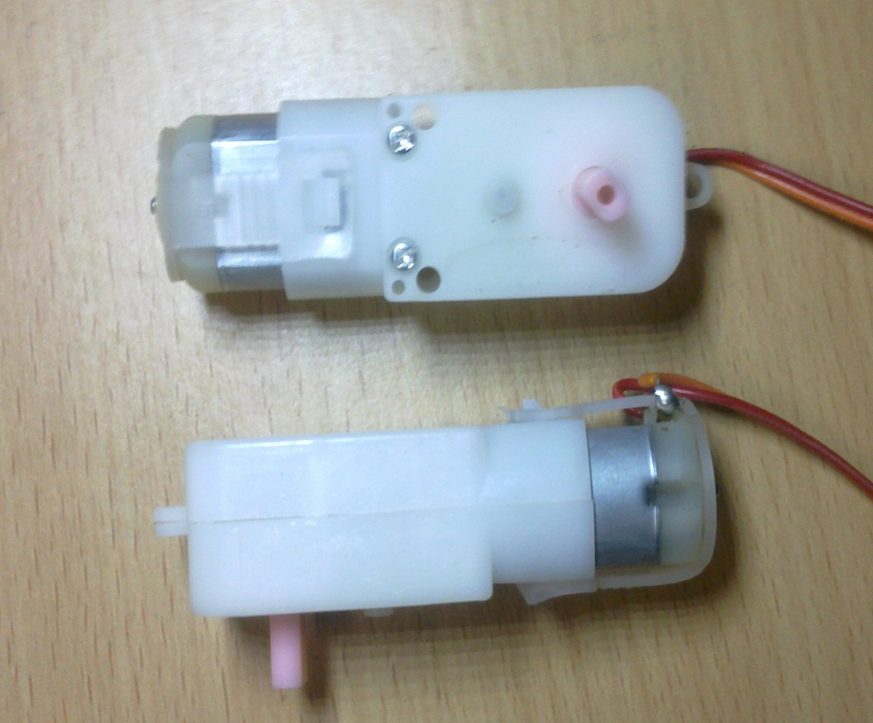
Society of Robotics and Automation, VJTI
Motors

Slide 5
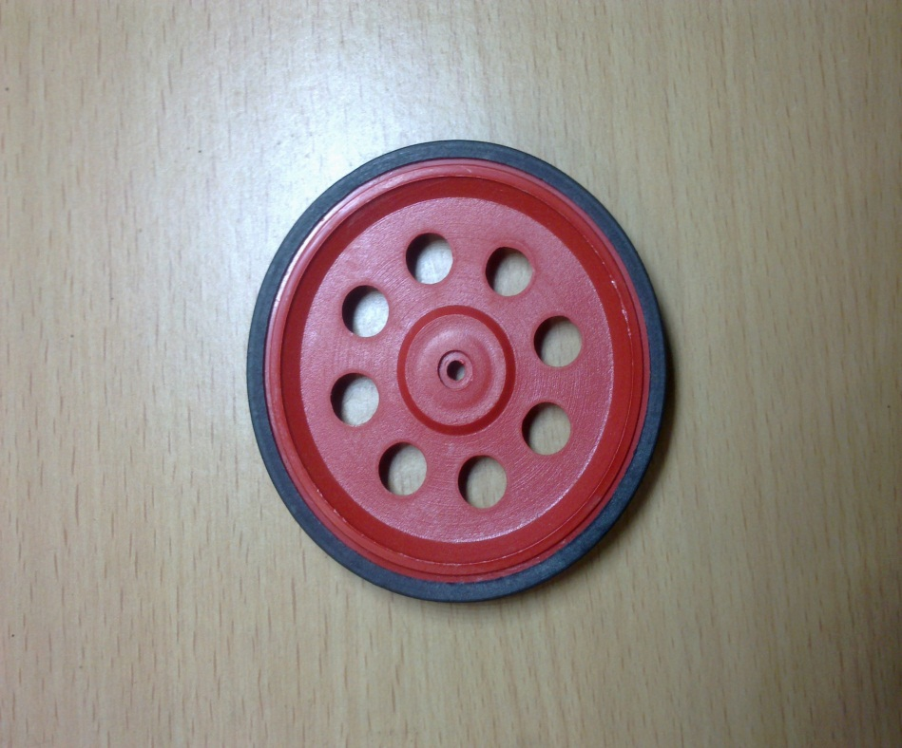
Society of Robotics and Automation, VJTI
Wheels

Slide 6
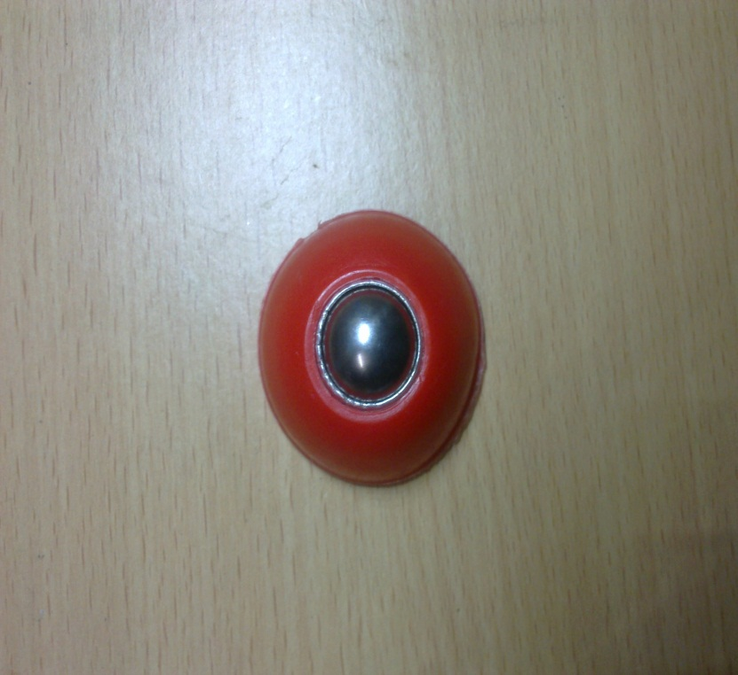
Society of Robotics and Automation, VJTI
Caster
A ball caster is a type of 'wheel' that allows smooth movement in all directions

Slide 7
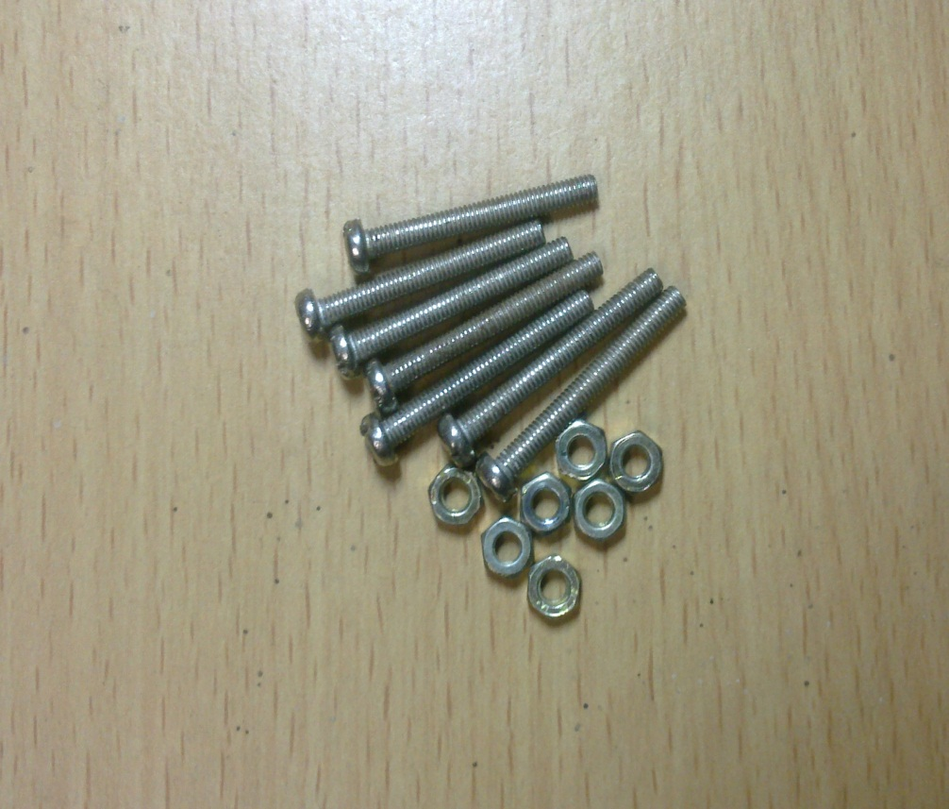
Society of Robotics and Automation, VJTI
Nuts and bolts

Slide 8
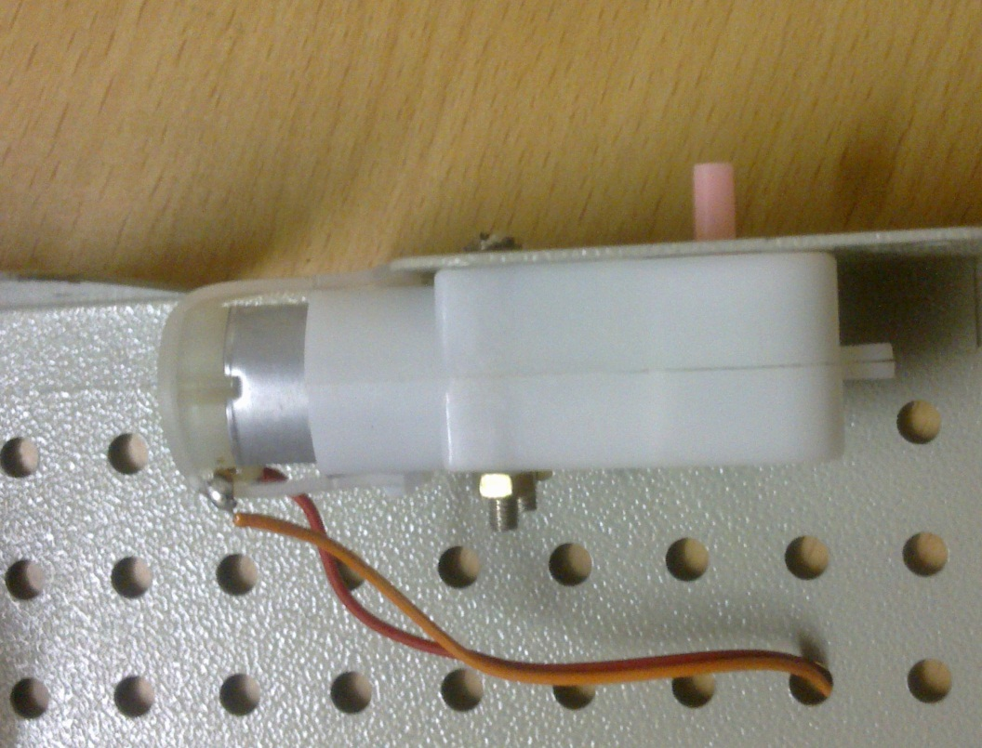
Society of Robotics and Automation, VJTI
Fix the motors to the chassis

Slide 9
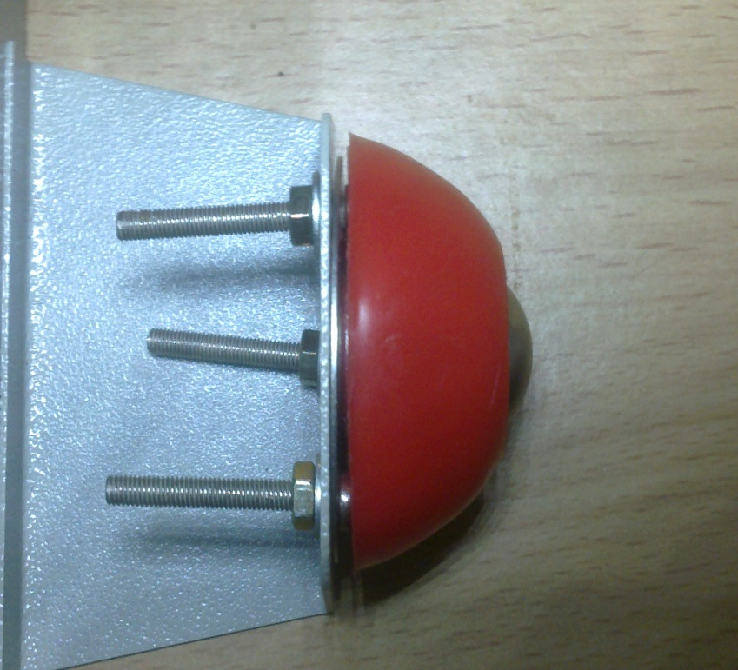
Society of Robotics and Automation, VJTI
Attach the caster

Slide 10
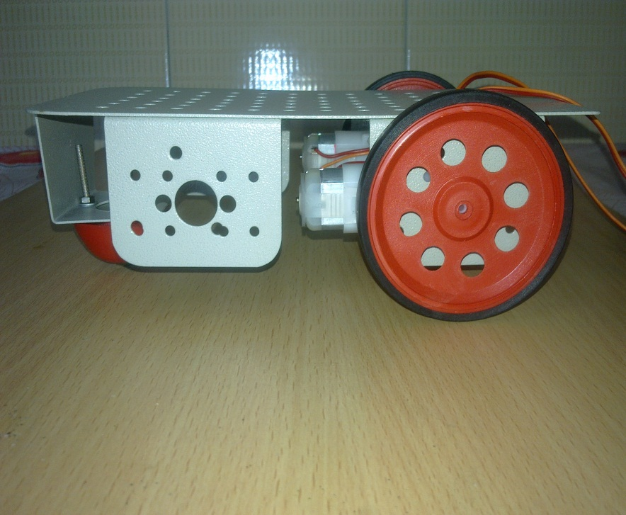
Society of Robotics and Automation, VJTI
Attach the wheels to the motors

Slide 11
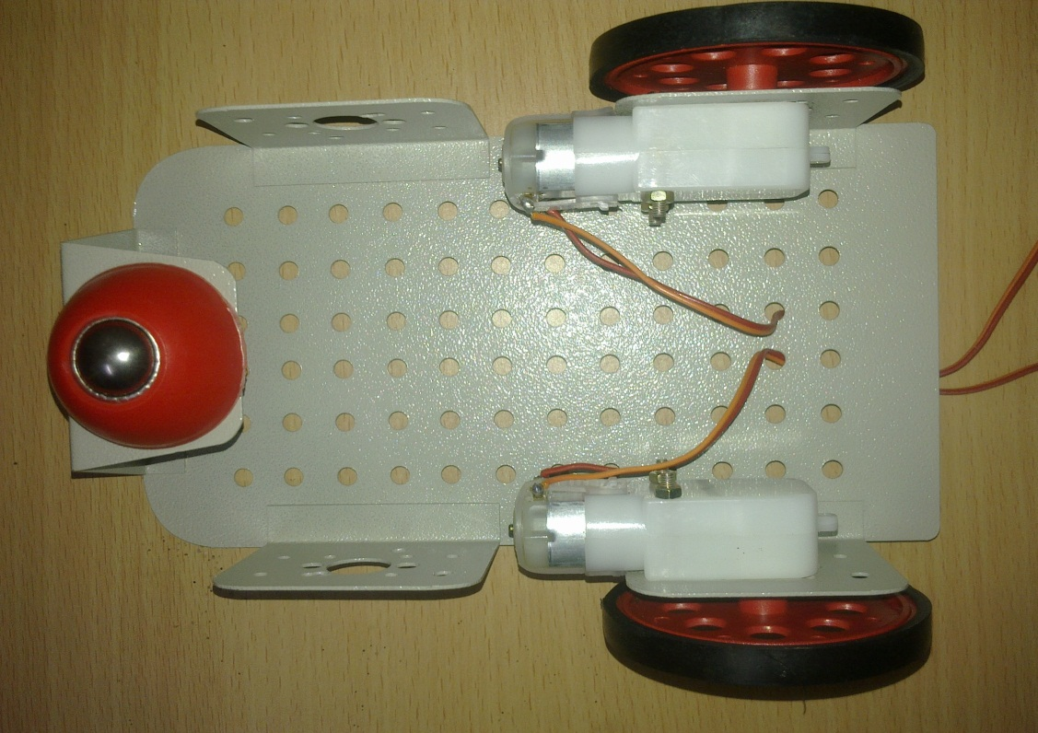
Society of Robotics and Automation, VJTI
Finally this is how it looks like

Slide 12
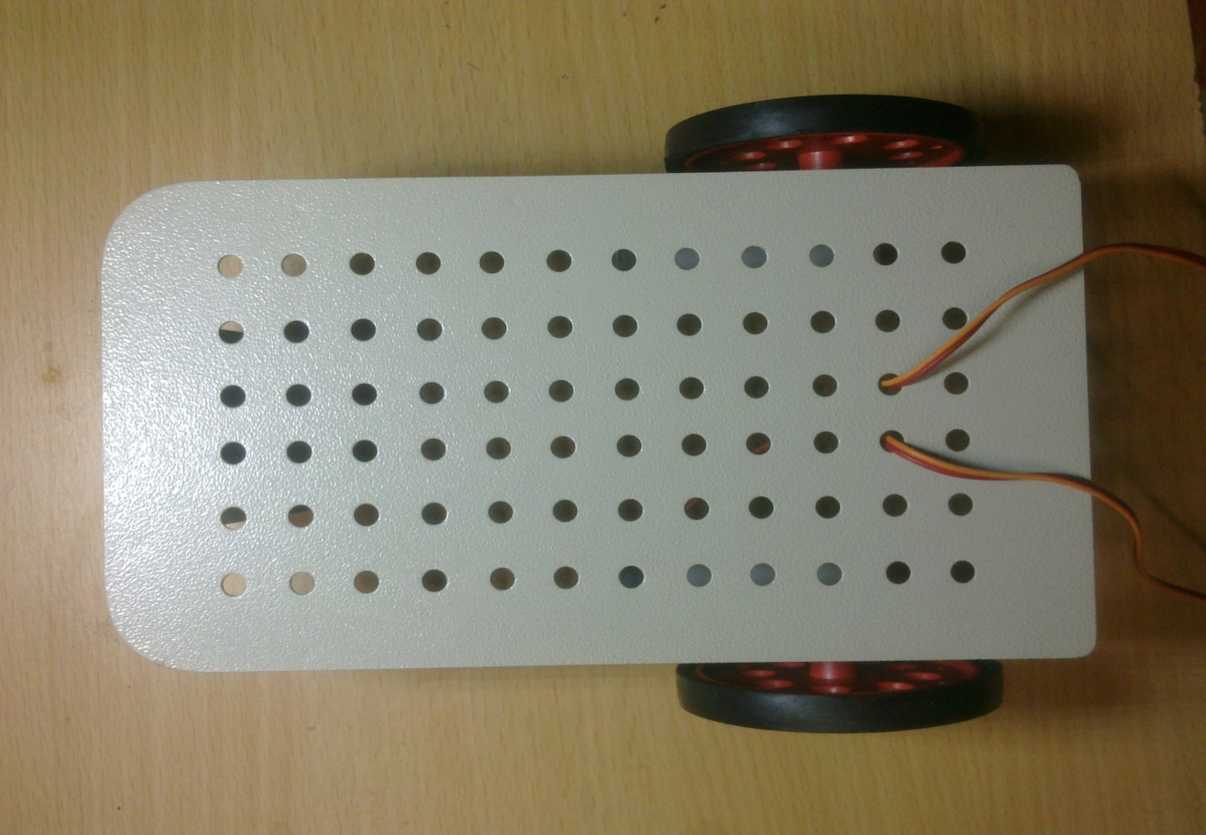
Society of Robotics and Automation, VJTI

